Slide 1
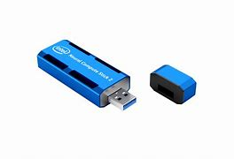

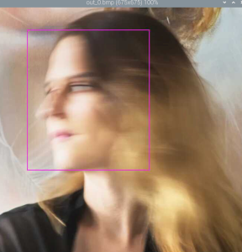
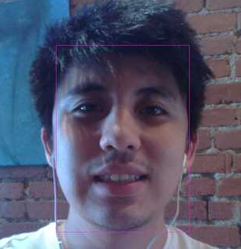

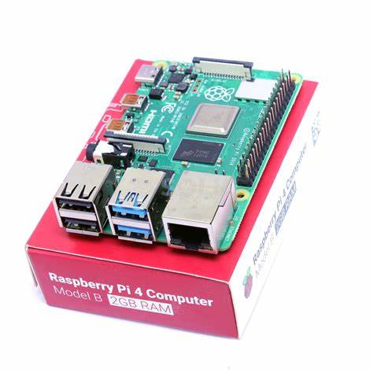
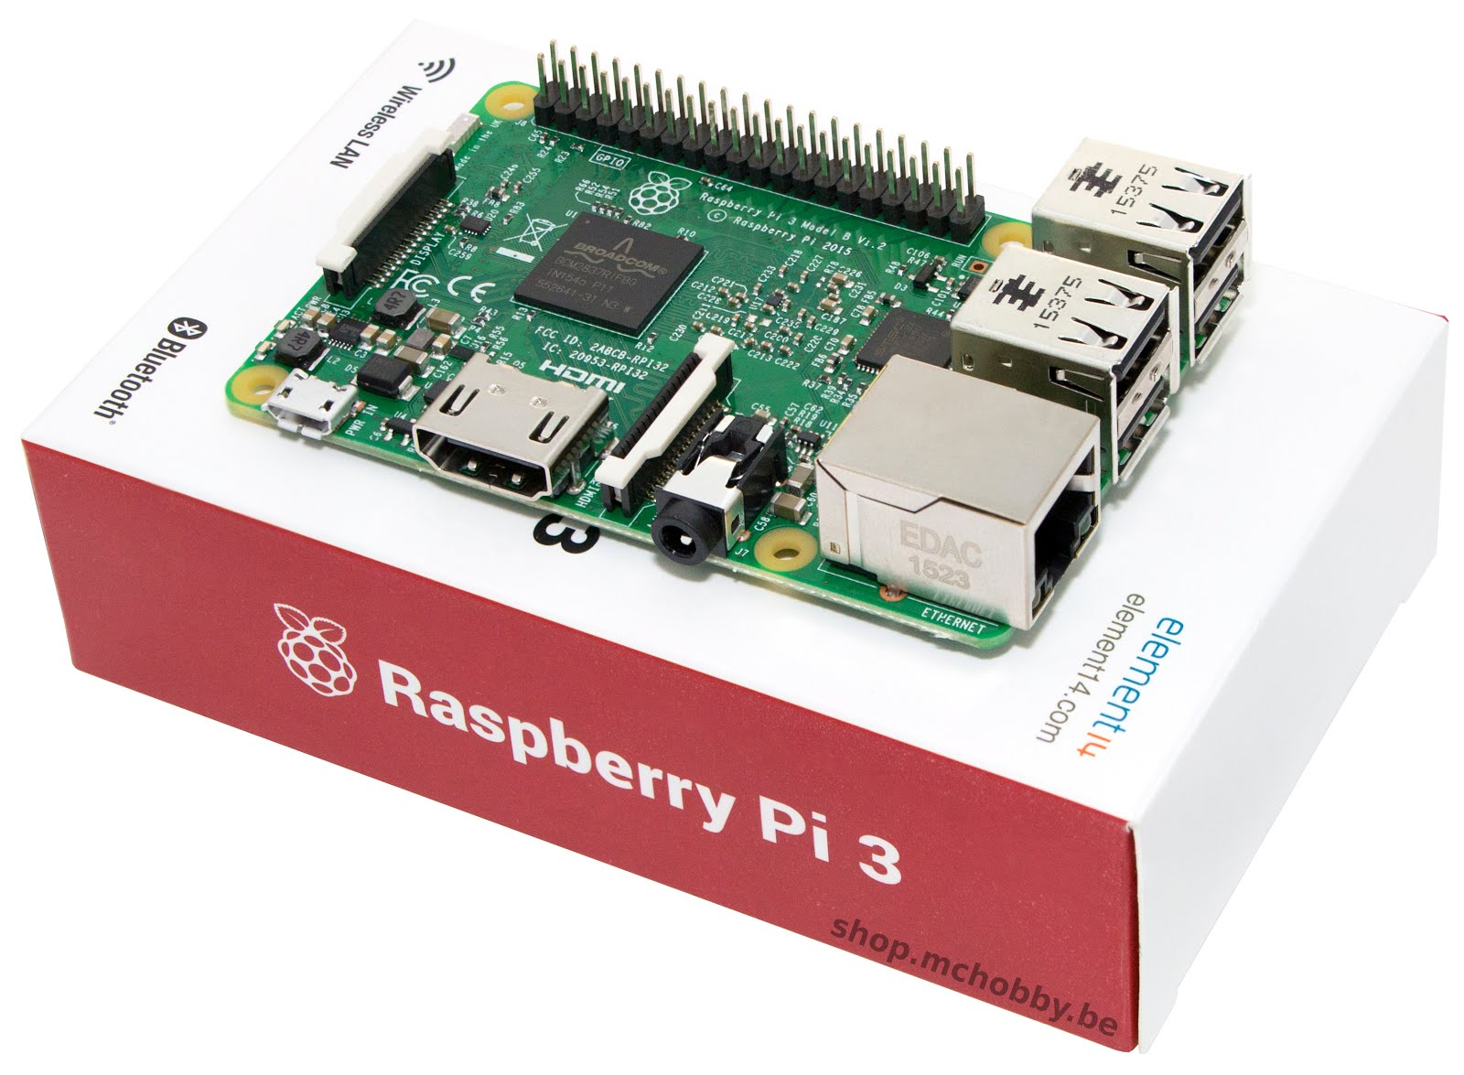
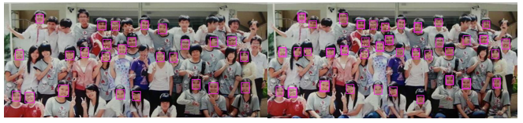
Facial Detection with Intel’s Neural Stick
This project uses the Intel Neural Stick to detect human faces in images!
Analyze execution time on two Linux-based single board computers.
Neural Compute Stick 2
Linux Operating System
Successfully Recognized
Successfully Recognized
Failed Recognition
Partially Recognized
Raspberry Pi 3
Raspberry Pi 4

